Slide 1
May 15 Lecture Slides
Dr. Chowdhury

Slide 2
Discussion Topics (15 min): “What’s Behind Rich People Pretending to be Self-made?” and “'The third era of Zuck': how the CEO went from hero to humiliation”
What is ERI? Whose idea is it? What are the two kinds of ERI and what are their negative consequences?
What do Donald Trump and Adam Roberts exemplify? What is the main difference between the two with relation to their attitude toward ERI?
According to Tim Hwang, what are “the three eras of Zuck”?
How did Mark Zuckerburg carefully construct his image as a successful entrepreneur hero? What led to the collapse of this image?

Slide 3
Entrepreneur as Cultural Hero Associated with
Youthfulness
Genius
Creativity
Effort & hard work
Being self-made
Little or no outside help
Great success, fame & wealth in little time
Deserves to have and enjoy
Individualism
Tries to balance by engaging in charitable activities
& a positive media image

Slide 4
Entrepreneur & American Dream
For Conservatives, entrepreneurs represent “original “American Dream
Personal effort, talent, discipline, hard work brings success and not government help
Healthy and free competition is real American Dream
few really successful entrepreneurs at any one given time makes American Dream worthwhile

Slide 5
Entrepreneur & American Dream
For liberals, entrepreneurs are often people who refuse to admit external help(government, community, family, etc.)
They are people who have an unfair head start
They allow conservatives to argue for limited government assistance and intervention
They are used as examples to blame people who “fail” according to biased standards
They don’t really work “hard”
Clever idea/invention, luck, investment, marketing lead to rapid success
They make a huge fortune too fast
They symbolize the unhealthy “all for myself and nothing for anyone else” brand of competition
real American dream is not to create few hugely successful entrepreneurs, but to give equal opportunities to all so that more people can succeed moderately

Slide 6
Discussion Topics: “Entrepreneur” by Angie Pelekidis 25 minutes
How does Clyde’s creation and development of an imaginary “entrepreneur story” provide you with an ironic view of some real-life entrepreneurs and their success stories?
How does the dream-Clyde as successful entrepreneur compare and contrast with the real-life Clyde as an average worker? In other words, which of the two Clydes do you think is a better human being? Why?
How does his “entrepreneur” fantasy prevent Clyde from having a meaningful relationship with Pam?
Do you think it is fair to say that Clyde’s life is a “failure”? “Failure” according to whose or what standards? What about Pam and her lifestyle?
What role did Clyde’s family background play in shaping his present life?

Slide 7
Answers
People try to market absurd and trivial inventions and sometimes succeed
ERI issue
Fortune and success are fickle, subject to volatile market forces and popular fads
Constant pressure to stay at top
Fear of failure
Great wealth power and fame do not bring lasting happiness
Great fall can come with great success

Slide 8
Real vs Entrepreneur Clyde
Entrepreneur Clyde is
Sexist
Classist
Racist
Abandons family and community
Self-centered

Slide 9
Real Clyde
Takes care of older sister
Generally kind & considerate
Tries to be different from sexist father
Pressure from main stream culture makes him fantasize about being successful
Donald Trump
Tony Robbins
Fantasy gets in the way of personal happiness and fulfillment

Slide 10
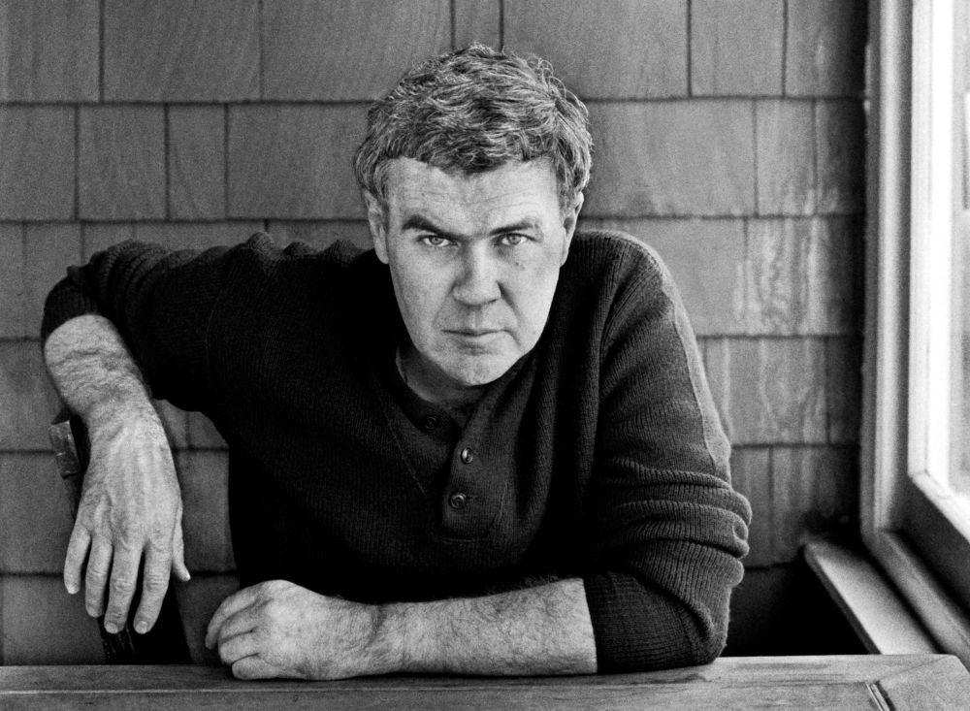
Raymond Carver (1938-1988) American Short Story Writer

Slide 11
Carver’s Life
Blue Collar family
Wrote about ordinary white people’s lives
Struggle with alcoholism and depression
Early death

Slide 12
Historical Context
Watergate Scandal
1975: Vietnam War ends in defeat
1979: Iranian Revolution & Hostage Crisis

Slide 13
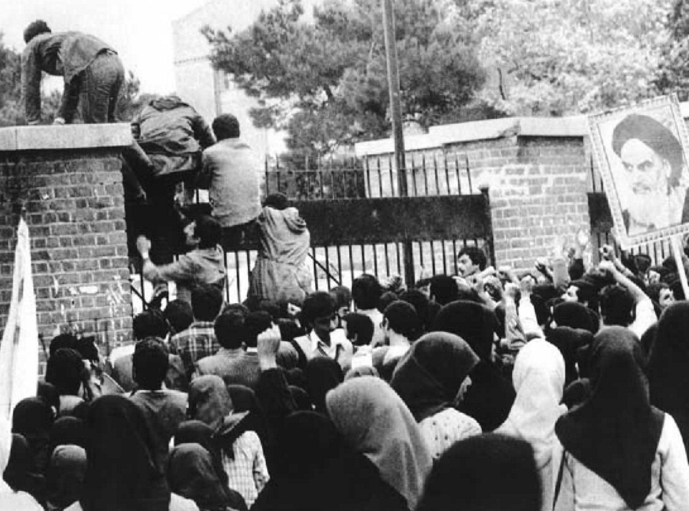
Iranians Storm U.S. Embassy

Slide 14
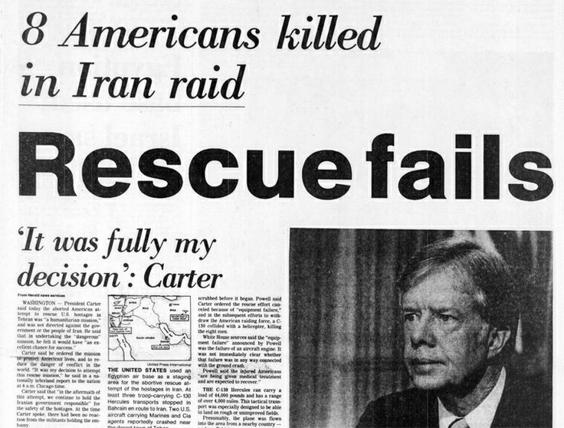
Failed American Rescue Attempt

Slide 15
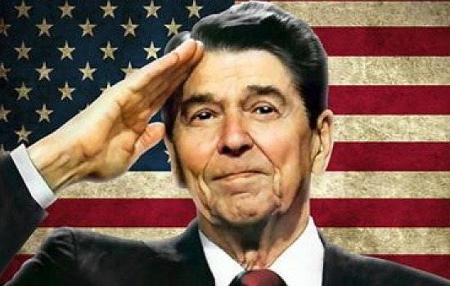
Ronald Reagan U. S President (1981-1991)

Slide 16
Social and Cultural context
Defeat leads to isolationism, on the one hand
More aggressive foreign policy, on the other
Economy booms for some but not for most
Lack of government control
“Everyman for himself” policy
Free but unregulated competition leads to greater gap between rich and poor
rich become richer while working class women and minorities suffer
Political scandals
Iran-Contra Affair
President’s mental health

Slide 17
Discussion Topics: “Cathedral” by Raymond Carver (20 min)
What are some examples of the narrator's prejudice against people with disabilities and minorities? Besides his personal prejudice Could there be other reasons why he says negative things about such people?
How does the story indirectly tells us that the narrator most likely has a mental disability? How does his social class and working conditions contribute to his illness?
Why does his wife fail to understand his disability? How does she make his condition even worse?
By contrast how does Robert show his understanding of the narrator’s disability and help him overcome it to some extent? How does even Robert, who has a physical disability, end up by mistreating the narrator?

